Slide 1
Attempting to Predict Kaggle Dataset Usability
Marc Marquez
University of Florida

Slide 2
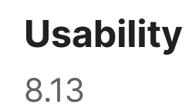
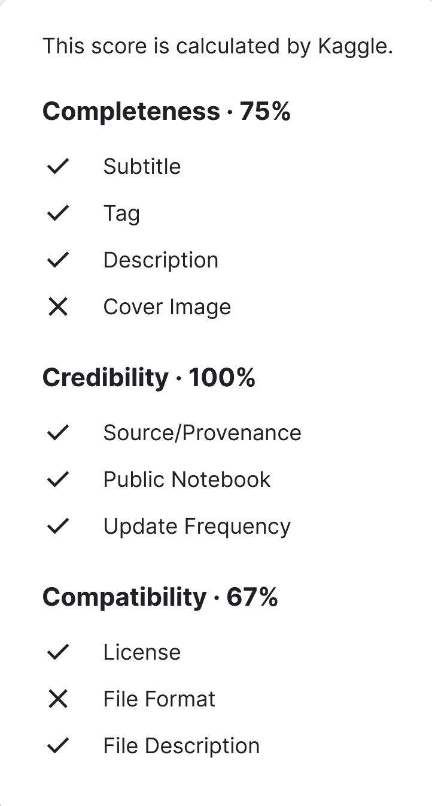

Background
What is Kaggle?
Website that features:
Data science courses, competitions, datasets
317,983 datasets as of 4/20/2024
Kaggle datasets have a Usability Rating
Unknown formula
Maybe there’s a way to predict it?

Slide 3
The Data
https://www.kaggle.com/datasets/rajugc/kaggle-dataset
9159 entries of dataset information:
Number of files
File size
Filetypes
Number of upvotes
Medal type (none, bronze, silver, gold)
Date (Months since 2015)
Day of upload
Usability (response)

Slide 4
Methods
Distributions of quantitative predictors:
Some have too many outliers
Log transformation can salvage file size
Drop number of files and number of upvotes
All are skewed, as well as Usability
Categorical predictors have enough entries per level
JSON and SQLITE incorporated into Other

Slide 5
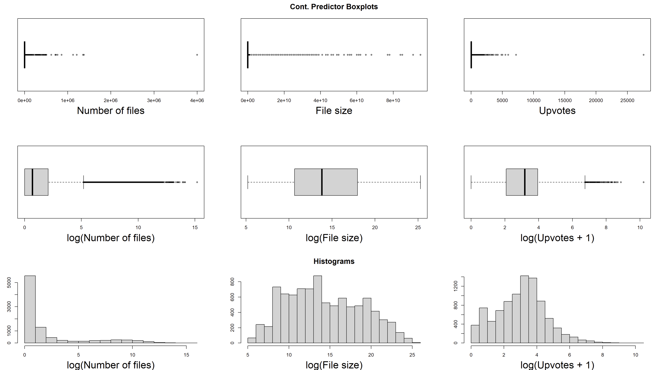

Slide 6
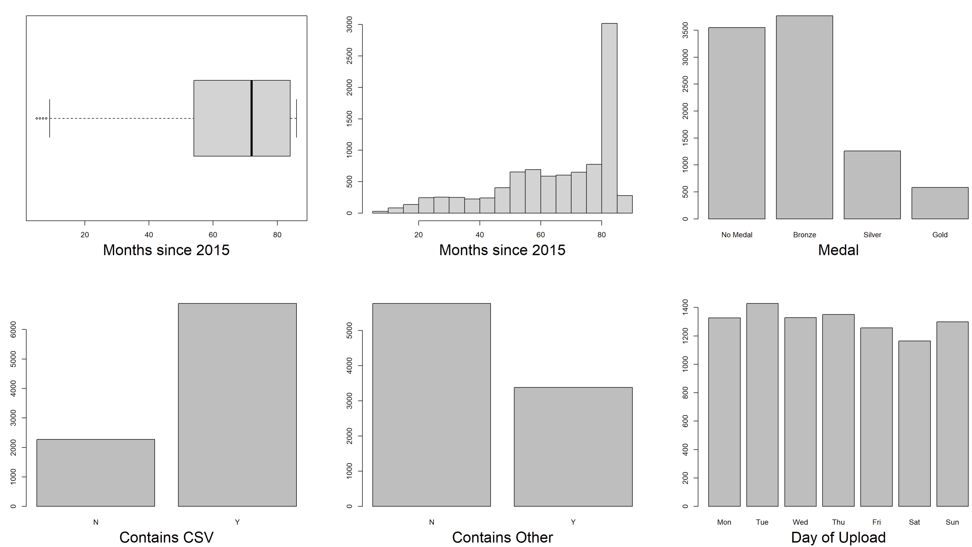

Slide 7
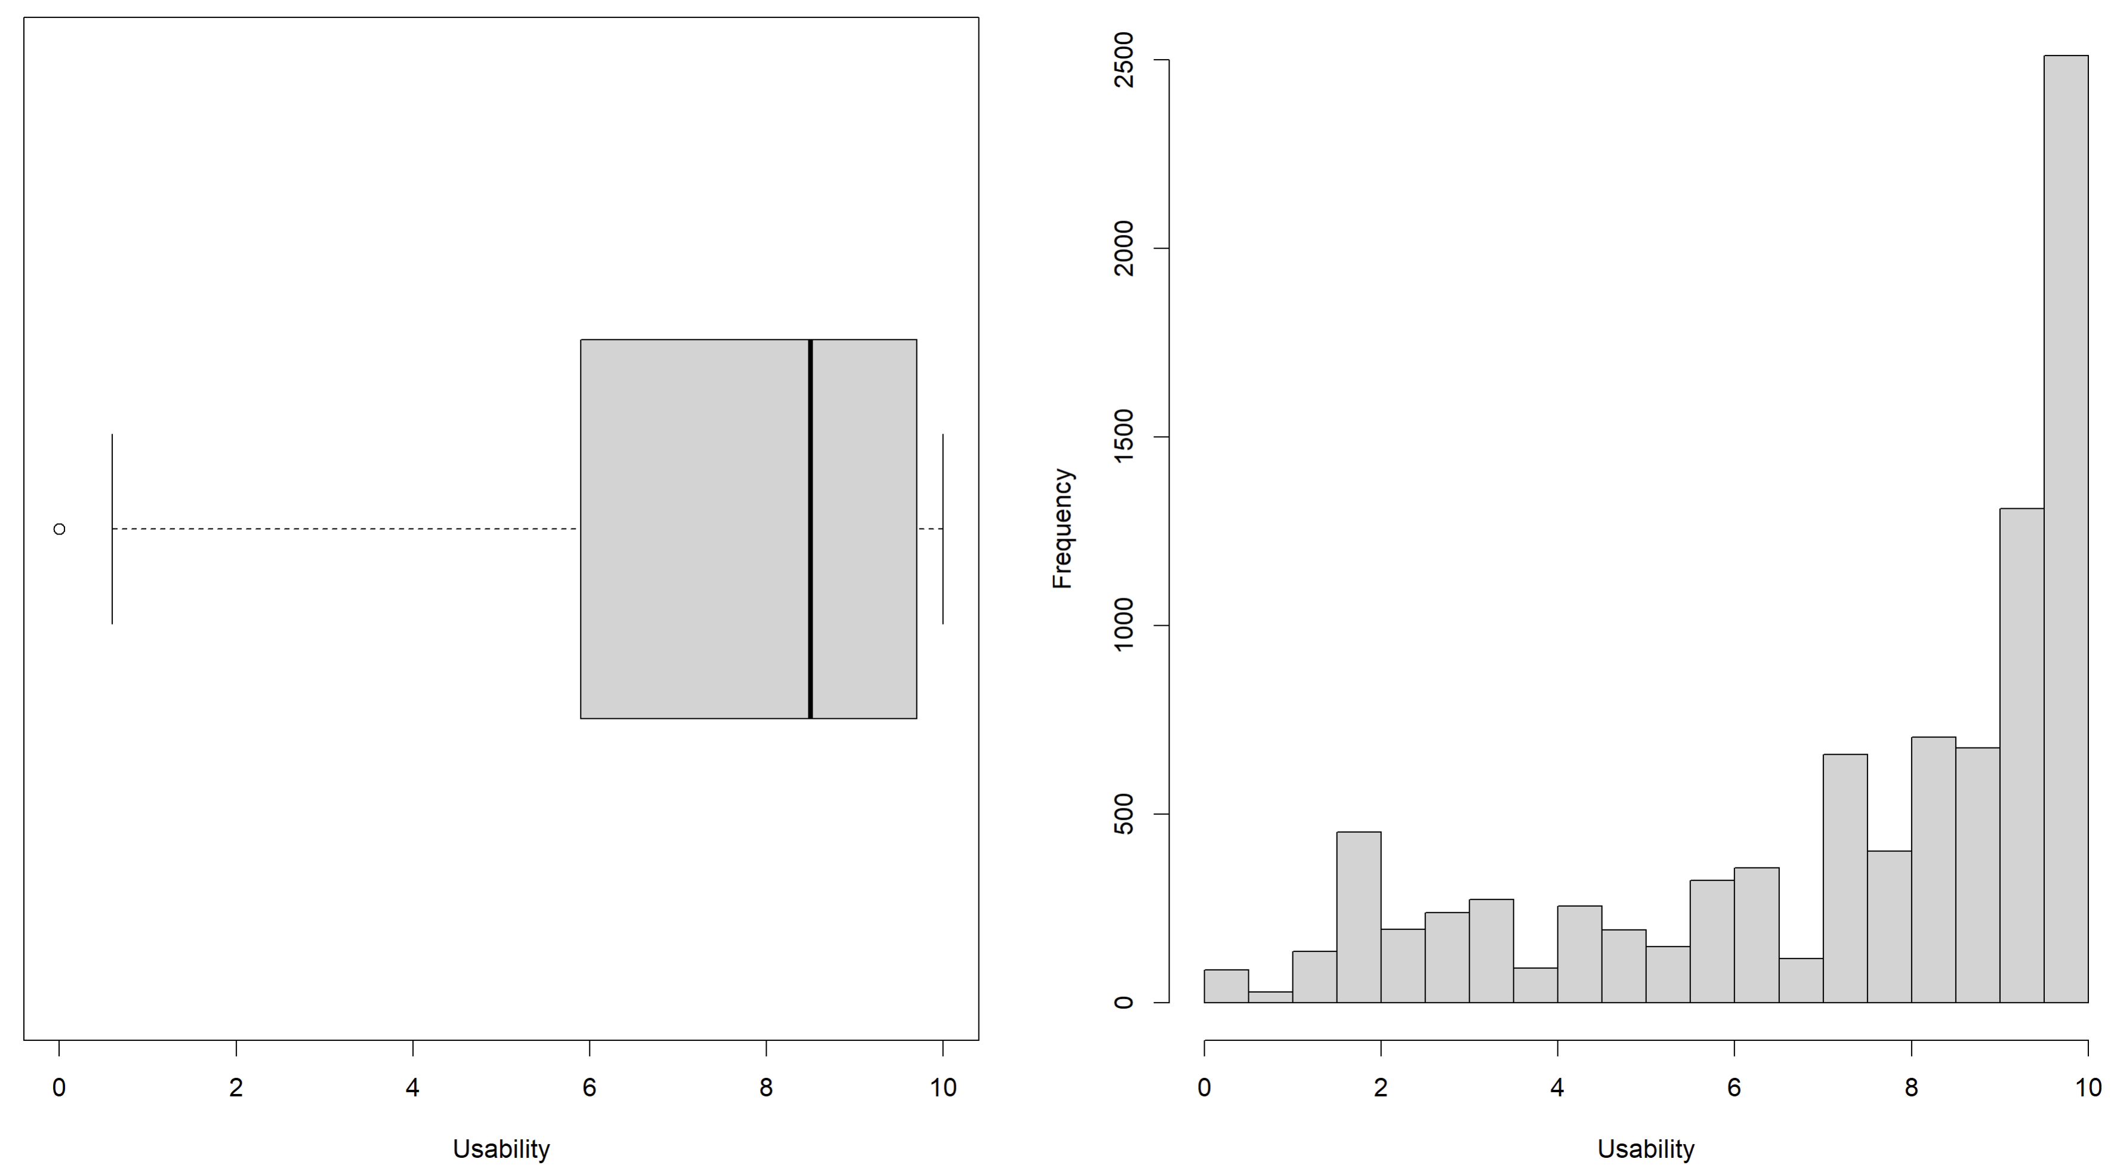

Slide 8
Usability plotted against each factor individually
log(File size) and Months since 2015 had no clear pattern
CSV, Other, and Medal appeared to have 1 significant difference in level
1 Factor Linear Models then fitted
Clear linear trend on all residual plots except Day
Extremely significant p-values on Levene and Breusch-Pagan tests
Likely due to Usability limits
Box-Cox and IWLS did not help

Slide 9
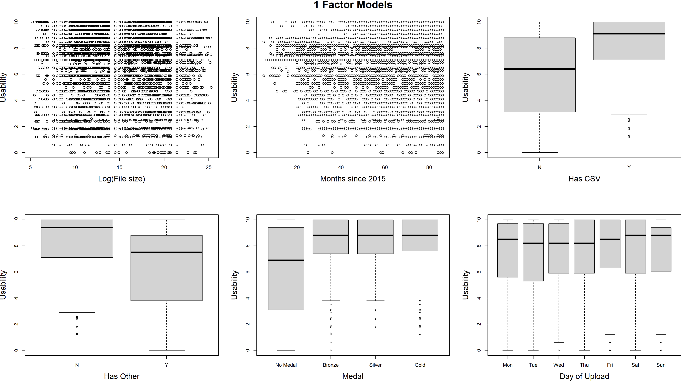

Slide 10
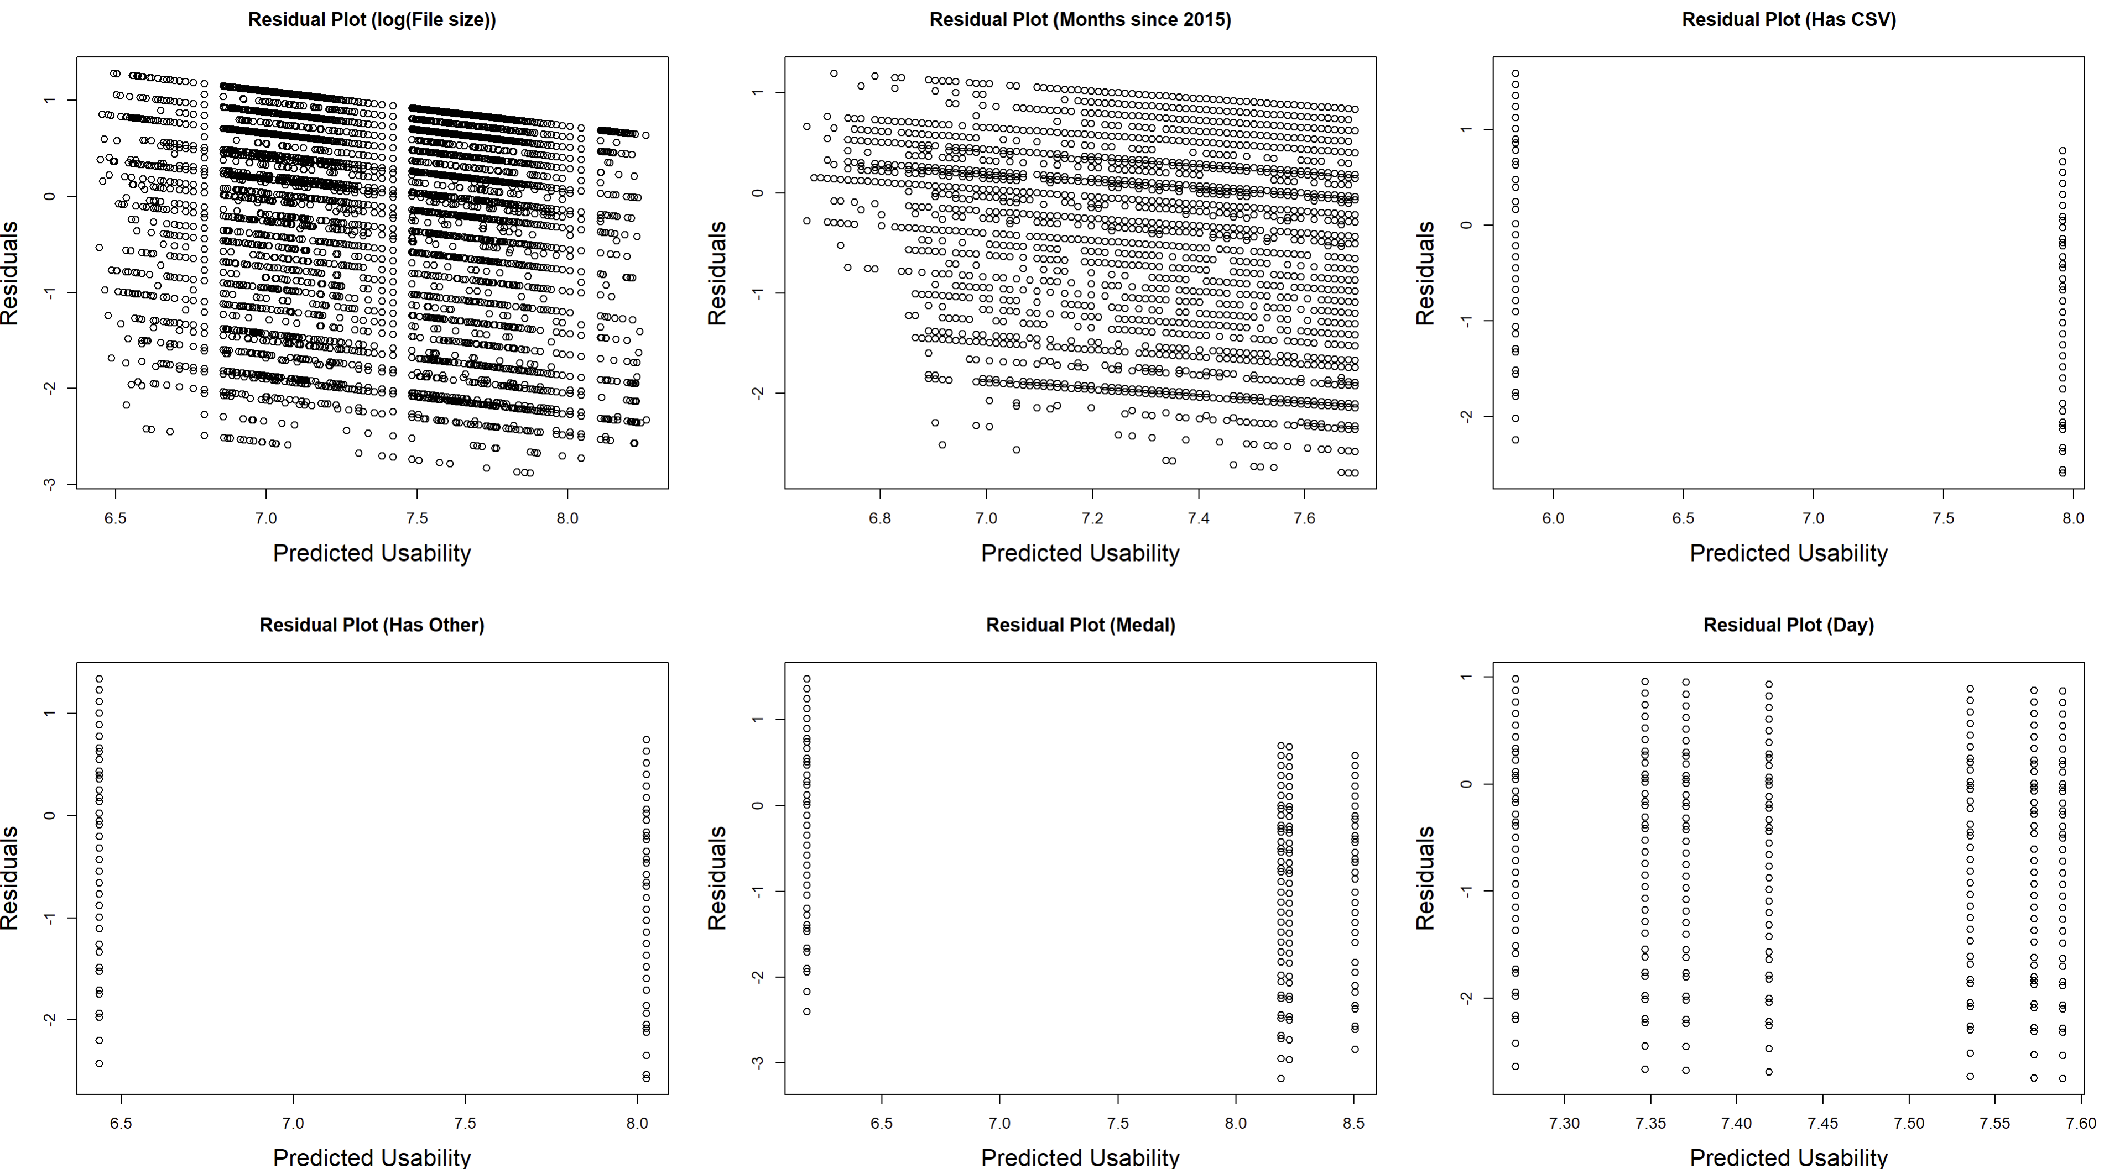

Slide 11
Parametric methods were insufficient
Use nonparametric methods instead
Tree-based models
Why trees?
Interpretable
Can capture complicated relationships
However:
Weak to outliers (transformation may fix)
Poor predictive performance

Slide 12
Multiple tree models were trained and tested
Basic Decision tree
Bagging tree
Random forest
Several boosted trees
Bayesian Additive Regression Trees
Model with smallest test error was selected

Slide 13
The Model
Boosted regression tree
2000 trees
Shrinking parameter of 0.01
Interaction depth of 4
Predictors:
log(File size), Months since 2015
Contains CSV file, Contains Other file, Medal, Day of upload

Slide 14
Results
Relative influence plot shows influence of each predictor:
Medal: 25.2352%
Months since 2015: 23.9388%
Log(File size): 23.3470%
CSV filetype: 13.7616%
Day of upload: 11.7600%
Other: 1.9575%

Slide 15
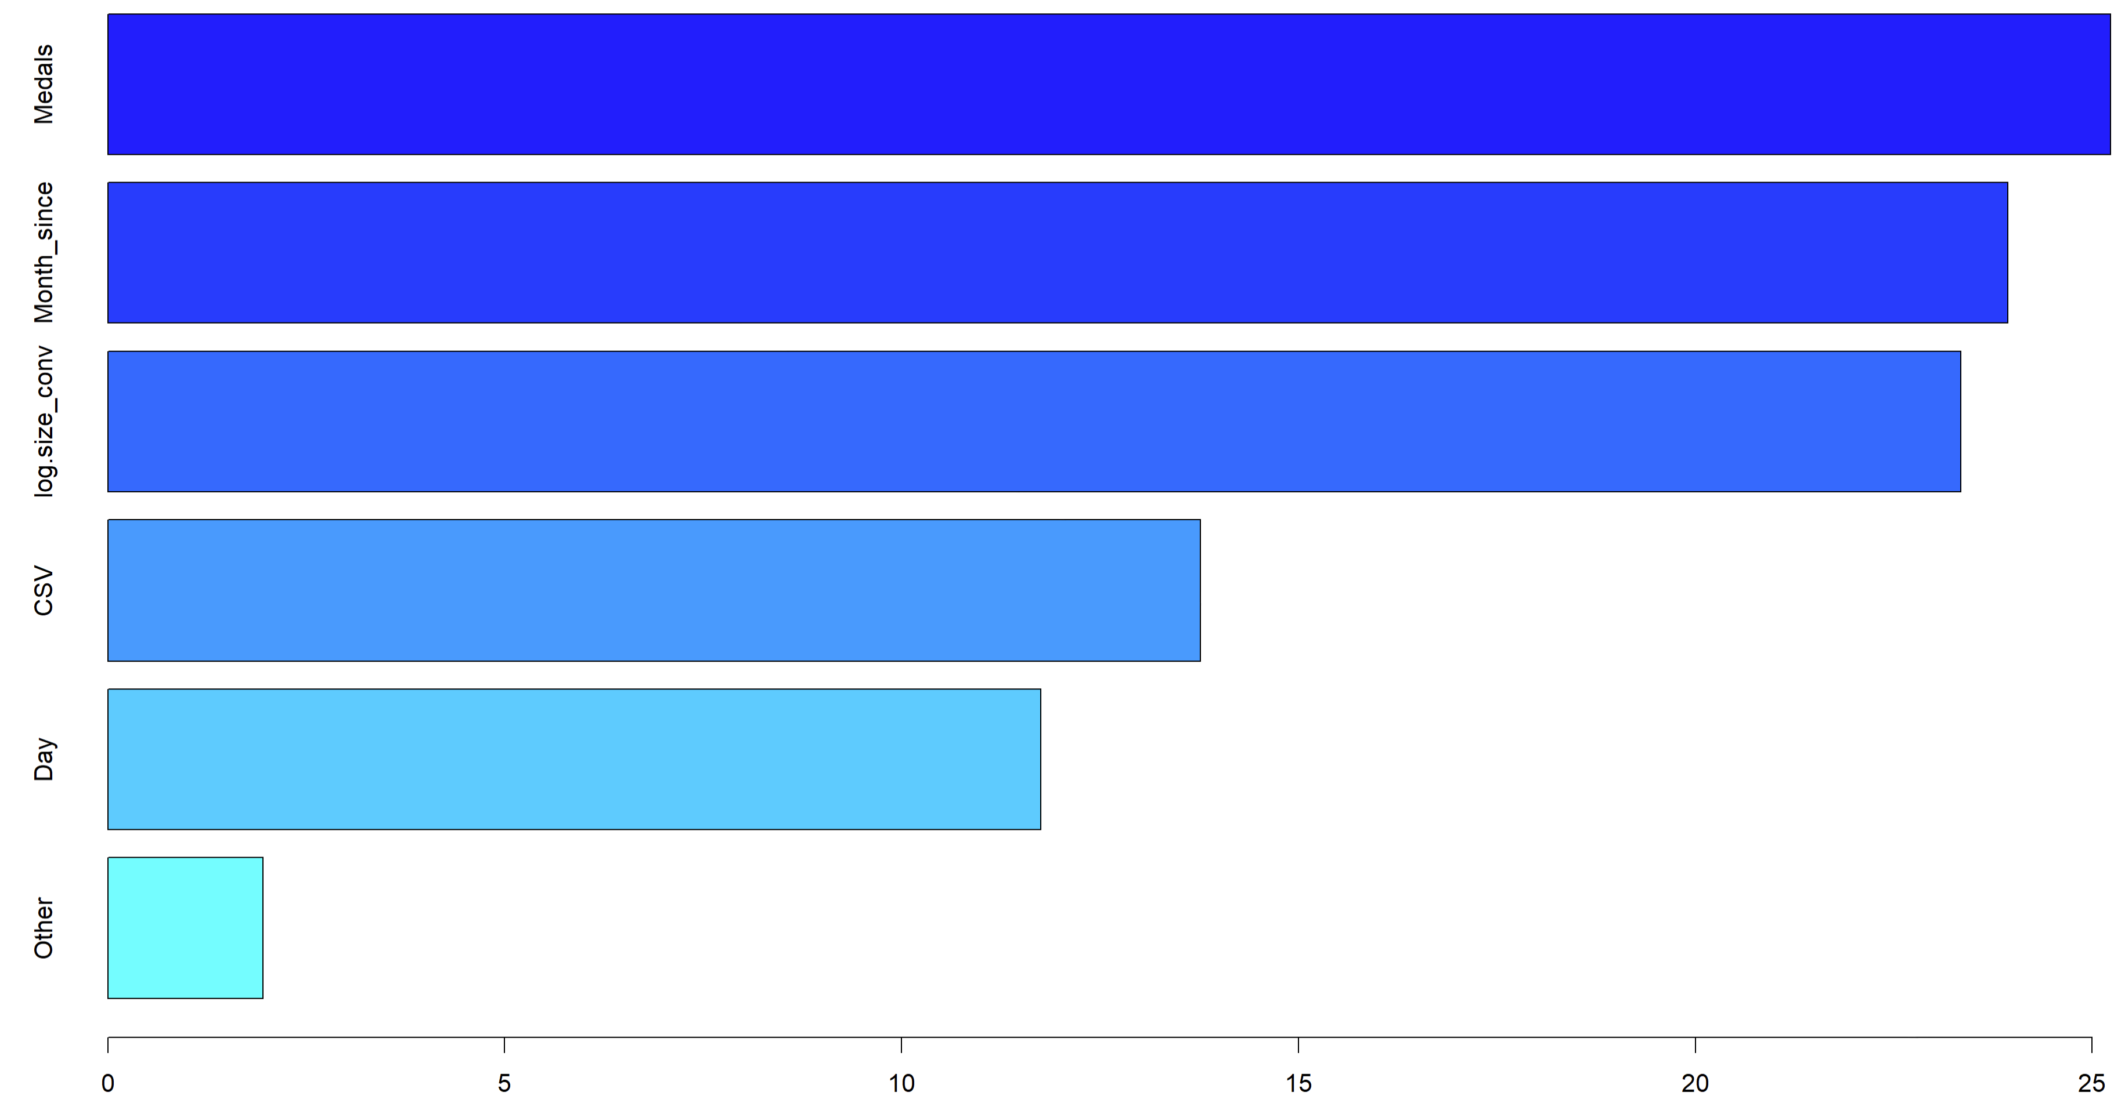

Slide 16
Partial dependence plots:
Datasets with no medals appeared to have less Usability than those that did
Datasets that included a CSV file appeared to have more Usability than those that did not
Mean test error of 5.1983
Rather poor for a scale of 0 to 10

Slide 17
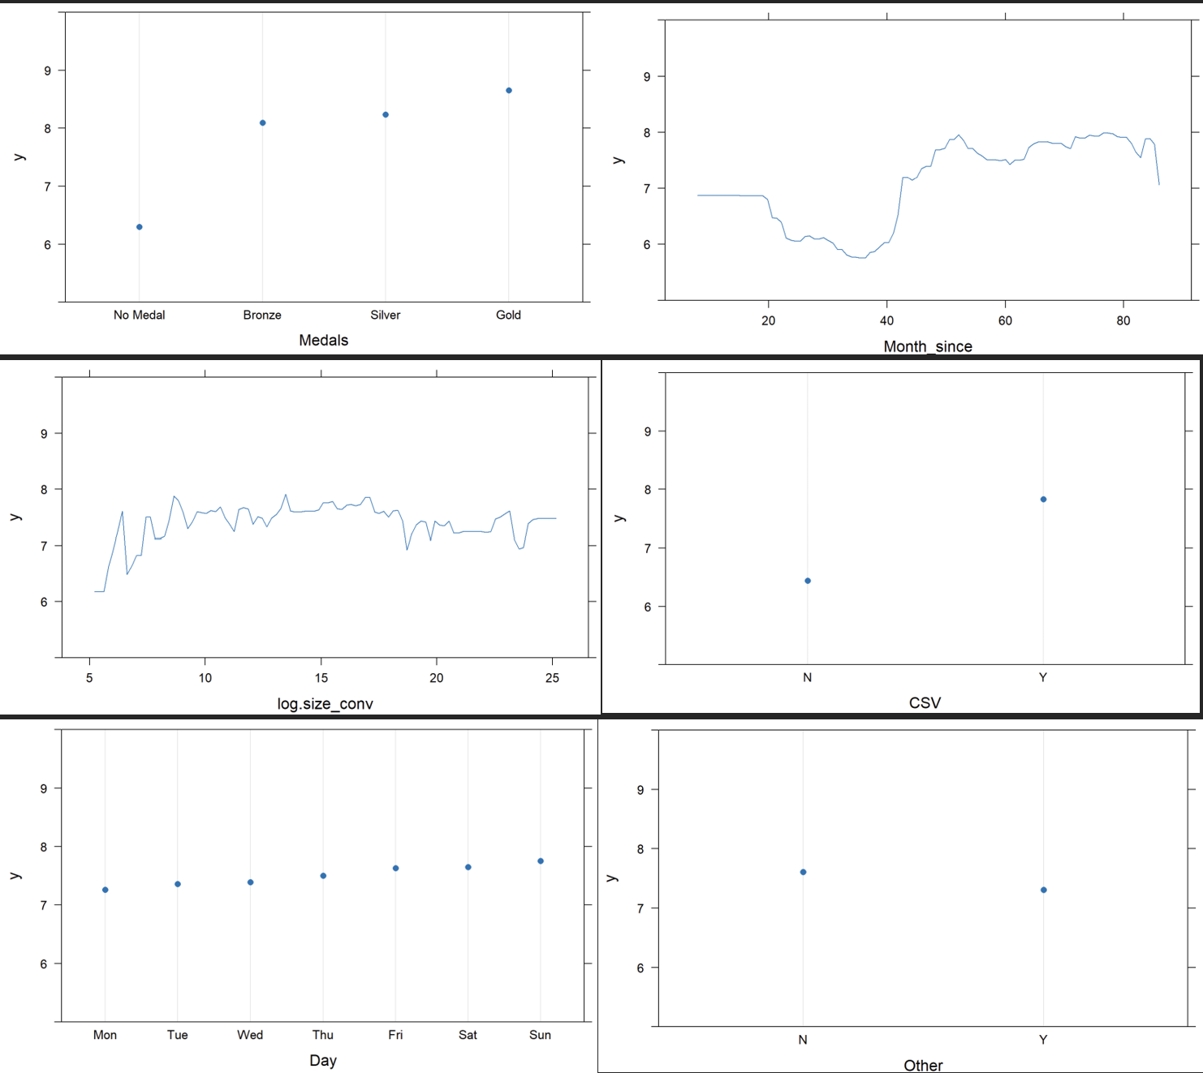

Slide 18
Conclusion
The variables are not as good of predictors of Usability as expected
What could help?
More/better data
Different predictors
“Usability” is subjective
Numerical scaling may be inadequate
The exact formula is unknown

